Slide 1
Data Structures Algorithm and Design SSZG519
Mr. Chennupati R Prasanna

Slide 2
SSZG519- Abstract Data Type

Slide 3
Abstract Data Type
Abstract Data Type
In computer science, an abstract data type
(ADT) is a mathematical model for a certain
class of data structures that have similar
behavior.

Slide 4
Abstract Data Types (ADTs)
A method for achieving abstraction for data structures and algorithms
ADT = model + operations
Describes what each operation does, but not how it does it
An ADT is independent of its implementation

Slide 5
Abstract Data Types
Typical operations on data
Add data to a data collection
Remove data from a data collection
Ask questions about the data in a data collection

Slide 6
Abstract Data Types
Data abstraction
Asks you to think what you can do to a collection of data independently of how you do it
Allows you to develop each data structure in relative isolation from the rest of the solution
A natural extension of procedural abstraction

Slide 7
Examples
Simple ADTs
Stack
Queue
Vector
Lists
Sequences
Iterators
All these are called Linear Data Structures

Slide 8
Stacks
A stack is a container of objects that are inserted and removed according to the last-in-first-out (LIFO) principle.
Objects can be inserted at any time, but only the last (the most-recently inserted) object can be removed.
Inserting an item is known as “pushing” onto the stack. “Popping” off the stack is synonymous with removing an item.

Slide 9
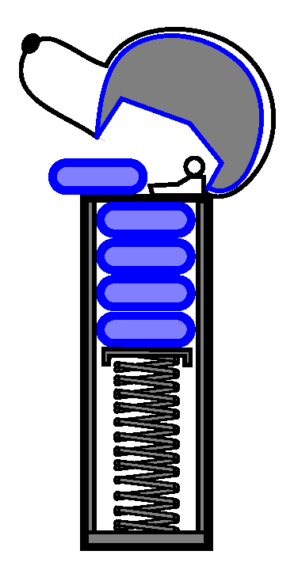
Stacks
A coin dispenser as an analogy:

Slide 10

Stacks: An Array Implementation
Create a stack using an array by specifying a maximum size N for our stack.
The stack consists of an N-element array S and an integer variable t, the index of the top element in array S.
Array indices start at 0, so we initialize t to -1

Slide 11
Stacks: An Array Implementation
Algorithm push(o) if size()==N then return Error t=t+1 S[t]=o
Algorithm pop() if isEmpty() then return Error t=t-1
return S[t-1]
Pseudo code
Algorithm size() return t+1
Algorithm isEmpty() return (t<0)
Algorithm top() if isEmpty() then return Error return S[t]

Slide 12
Stacks: An Array Implementation
The array implementation is simple and efficient
(methods performed in O(1)).
Disadvantage
There is an upper bound, N, on the size of the
stack.
The arbitrary value N may be too small for a
given application OR
a waste of memory.

Slide 13
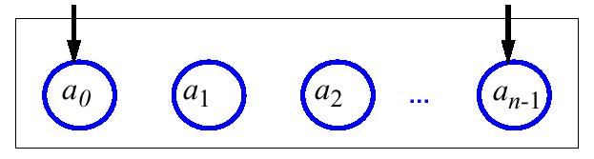
Queues
A queue differs from a stack in that its insertion and removal routines follows the first-in-first-out (FIFO) principle.
Elements may be inserted at any time, but only the element which has been in the queue the longest may be removed.
Elements are inserted at the rear (enqueued) and removed from the front (dequeued)
Front
Queue
Rear

Slide 14
Queues
The queue supports three fundamental methods:
New():ADT – Creates an empty queue
Enqueue(S:ADT, o:element):ADT - Inserts object o at the rear of the queue
Dequeue(S:ADT):ADT - Removes the object from the front of the queue; an error occurs if the queue is empty
Front(S:ADT):element - Returns, but does not remove, the front element; an error occurs if the queue is empty

Slide 15
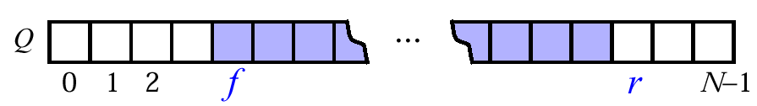
Queues: An Array Implementation
Create a queue using an array in a circular fashion
A maximum size N is specified.
The queue consists of an N-element array Q and two integer variables:
f, index of the front element (head – for dequeue)
r, index of the element after the rear one (tail – for enqueue)
Initially, f=r=0 and the queue is empty if f=r

Slide 16
Queues
Disadvantage
Repeatedly enqueue and dequeue a single
element N times.
Finally, f=r=N.
No more elements can be added to the queue,
though there is space in the queue.
Solution
Let f and r wraparound the end of queue.

Slide 17
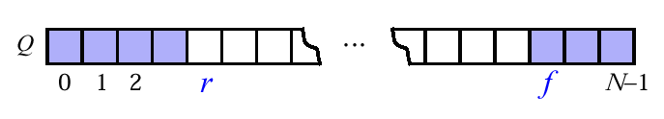
Queues: An Array Implementation
“wrapped around” configuration
Each time r or f is incremented, compute this increment as (r+1)modN or (f+1)modN

Slide 18
Queues: An Array Implementation
Pseudo code
Algorithm dequeue() if isEmpty() then return Error Q[f]=null f=(f+1)modN
Algorithm enqueue(o) if size = N - 1 then return Error Q[r]=o r=(r +1)modN
Algorithm size() return (N-f+r) mod N
Algorithm isEmpty() return (f=r)
Algorithm front() if isEmpty() then return Error return Q[f]

Slide 19
Arrays: pluses and minuses
+ Fast element access.
-- Impossible to resize.
Many applications require resizing!
Required size not always immediately available.

Slide 20
Singly Linked Lists
A singly linked list is a concrete data structure consisting of a sequence of nodes
Each node stores
element
link to the next node
next
elem
node
∅
A
B
C
D
20

Slide 21
Doubly Linked List
A doubly linked list is often more convenient!
Nodes store:
element
link to the previous node
link to the next node
Special trailer and header nodes
prev
next
elem
node
header
nodes/positions
trailer
elements

Slide 22
Insertion
We visualize operation insertAfter(p, X), which returns position q
p
A
B
C
p
A
B
q
C
X
p
q
A
B
X
C

Slide 23
Insertion Algorithm
Algorithm insertAfter(p,e):
Create a new node v
v.setElement(e)
v.setPrev(p) {link v to its predecessor}
v.setNext(p.getNext()) {link v to its successor}
(p.getNext()).setPrev(v) {link p’s old successor to v}
p.setNext(v) {link p to its new successor, v}
return v {the position for the element e}

Slide 24
Deletion
We visualize remove(p), where p == last()
p
A
B
C
D
A
B
C
p
D
A
B
C

Slide 25
Deletion Algorithm
Algorithm remove(p):
t = p.element {a temporary variable to hold the return value}
(p.getPrev()).setNext(p.getNext()) {linking out p}
(p.getNext()).setPrev(p.getPrev())
p.setPrev(null) {invalidating the position p}
p.setNext(null)
return t

Slide 26
Worst-cast running time
In a doubly linked list
+ insertion at head or tail is in O(1)
+ deletion at either end is on O(1)
-- element access is still in O(n)

Slide 27
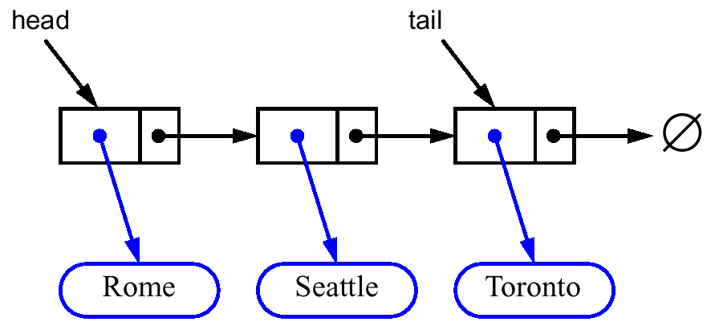
Stacks: Singly Linked List implementation
Nodes (data, pointer) connected in a chain by links
the head or the tail of the list could serve as the top of the stack

Slide 28
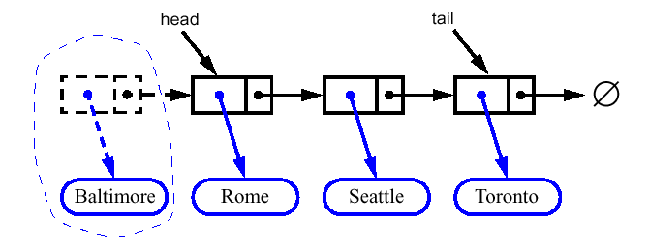
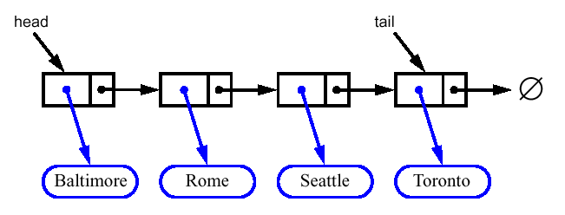
Queues: Linked List Implementation
Dequeue - advance head reference

Slide 29
Thank You!!

